Slide 1
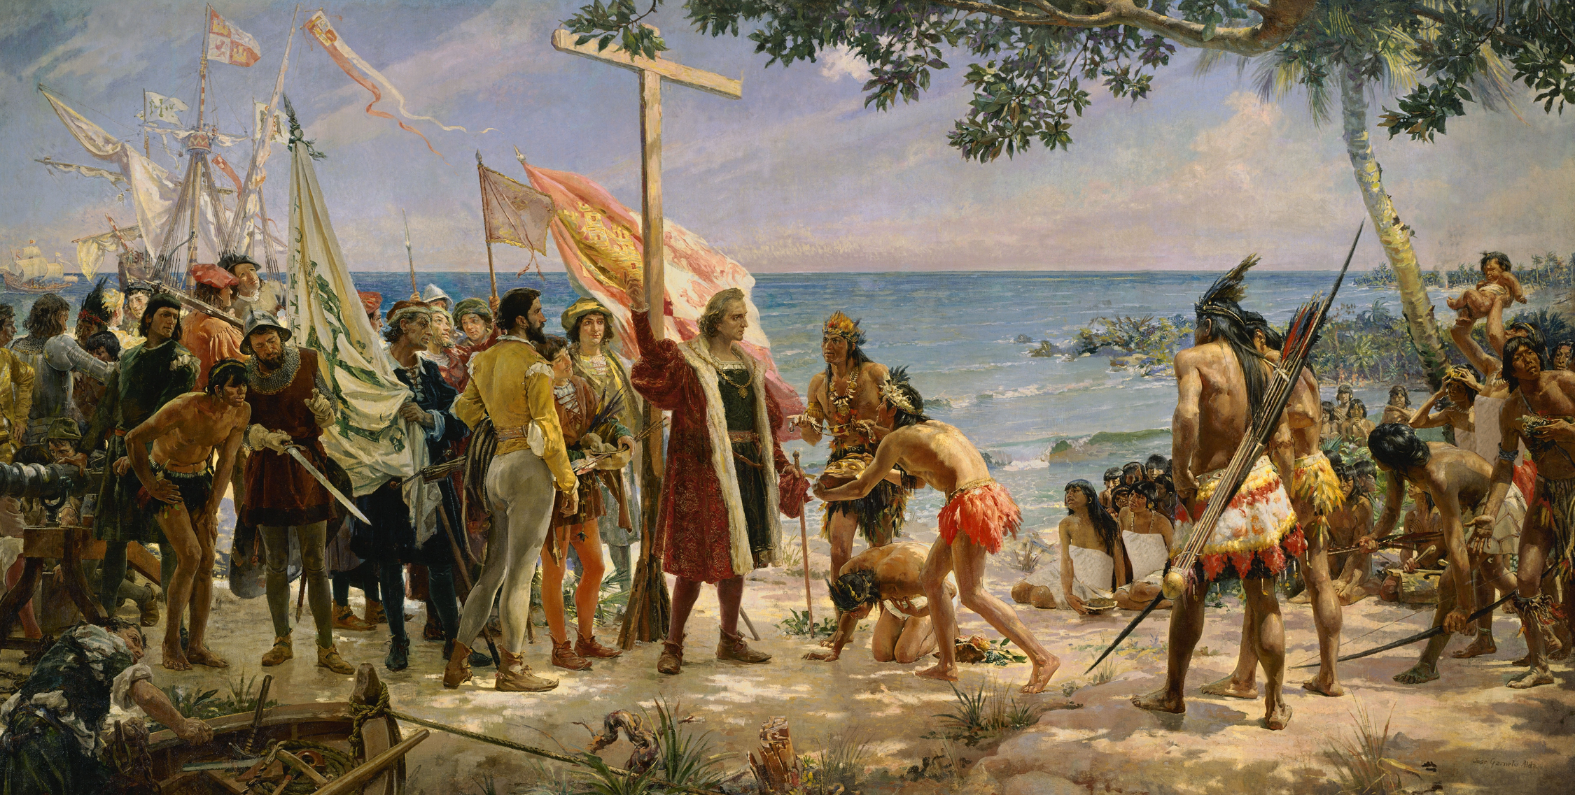
New Global Connections (1415-1796)
Topic 5 Lesson 3 European Conquests in the Americas

Slide 2
New Global Connections (1415-1796)
Topic 5 Lesson 3 European Conquests in the Americas
Key Terms
Taíno
conquistadors
immunity,
Hernán Cortés.
Tenochtitlán
Malinche
alliances
Moctezuma
Francisco Pizarro
civil war.
privateers,
viceroys,
encomiendas
Bartolomé de Las Casas
peons,
peninsulares
creoles,
mestizos,
mulattoes,

Slide 3
New Global Connections (1415-1796)
Topic 5 Lesson 3 European Conquests in the Americas
Learning Objectives
Analyze the results of the first encounters between the Spanish and Native Americans.
Explain how the Aztec and Inca empires were impacted by Spanish conquistadors and European colonization.
Describe how Portugal and other European nations challenged Spanish power.
Analyze the major features of Spanish colonial government, society and culture.
Describe the impact of Spanish colonization of the Americas.

Slide 4
First Encounters
The Taínos Meet Columbus
At first the Tainos were very friendly, but Columbus and his men took their gold, took some back to Spain forcibly, and forced them to find more gold
A wave of conquistadors from Spain will do the same in other Caribbean Islands, including forcing them to convert
Guns, Horses, and Disease
The Spaniards are going to have many advantages over the Native Americans
Bows and arrows are no match for guns
They have never seen horses before and are afraid
They have no immunities to smallpox, measles, and influenza
90% of the population will die to these disease in the 1500’s

Slide 5
First Encounters
First Tribute to Columbus (1892) by Spanish artist José Garnelo y Alda represents the first meeting with the Taíno. Hypothesize Do you think the encounter actually appeared like this? Why or why not?

Slide 6
Cortés Conquers the Aztecs
Cortés Arrives in Mexico
Hernan Cortes hears about Mexico and decides he wants to go invade. In 1519 he heads over with 600 men, 16 horses, and a few cannon
Malinche, a young woman, joins Cortez and advises him to make alliances with other tribes to fight the Aztecs
Moctezuma’s Dilemma
Moc believes that Cortez might be an Aztec God that said he would come back from the east. In order not to anger the God he sends gifts but tells him not to continue to the capital
Cortes will continue to the capital inspired by the gold and silver
Cortés Takes Tenochtitlán
Moc will greet Cortes when he reaches the capital. However Cortes will take Moc hostage and make him sign over land and treasure to the Spanish

Slide 7
Cortés Conquers the Aztecs
Cortés Takes Tenochtitlán
However a new group of Spanish conquistadors is going to arrive from Cuba to challenge Cortez
There will be multiple groups fighting for control
The Aztecs will drive of Cortes from the capital
Half of the Spaniards will be killed and so will Moc
Cortes retreats and in 1521 he comes back and destroys the capital with his allies. They build Mexico City on the ruins
Smallpox will also decimate the population like before

Slide 8
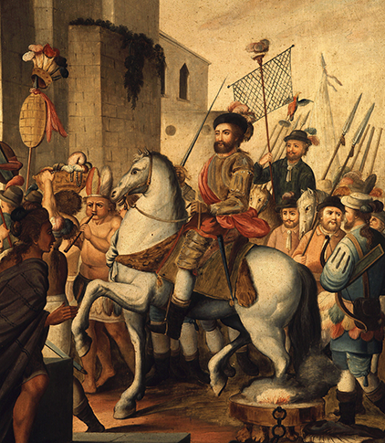
Cortés Conquers the Aztecs
After fighting with Tlaxcalans, Cortés and his men were welcomed into Tlaxcala. The Tlaxcalans became allies of the Spanish in the conflict with the Aztecs.

Slide 9
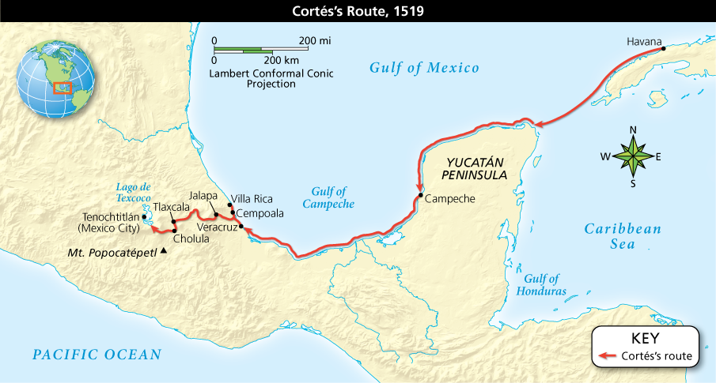
Cortés Conquers the Aztecs
Analyze Maps Why do you think Cortés’s ships sailed so close to the Mexican coast?

Slide 10
The Incan Empire and Beyond
Atahualpa Resists
Atahualpa will meet with Pizzaro and Pizzaro will take him prisoner. He ransoms him for a room filled with gold and one with silver. He will still kill Atahualpa when he gets the treasure
Pizarro Triumphs
Pizzaro will triumph over the Incas b/c of his superior firepower
Beyond Spain’s Empire
In 1530’s Port. Govt. will issue land grants to nobles to settle the land and share profits in Brazil
Because there is no gold or silver they will cut and export brazil wood, giving Brazil its name. They will turn to plantation agriculture and raising cattle
This will lead to forcing Native Americans and Africans to clear the land. This will bring 4 million Africans to Brazil

Slide 11
The Incan Empire and Beyond
Challenges to Portugal and Spain
Other European countries are jealous of Spain and Portugal’s wealth
To get around those countries strict trading policies England, France, and the Dutch will trade illegally with colonists
They will also prey on treasure ships, some with their countries consent, being called privateers
Others will continue exploring the coast, looking for gold and silver, as well as a northwest passage to Asia

Slide 12
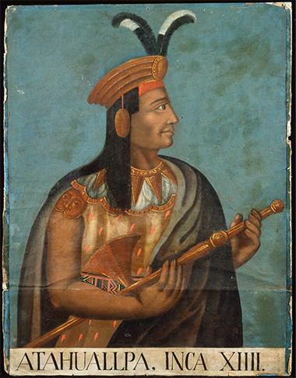
The Incan Empire and Beyond
Atahualpa, portrayed here by an unknown painter in the 1500s, was the thirteenth and last Incan ruler.

Slide 13
Governing the Spanish Empire
Royal Officials Rule the Provinces
Spanish king will set up Council of Indies to pass laws for colonies
Viceroys will rule in each province
Lesser officials and audiencias (Spanish settlers) will help Viceroy
The Council will watch Viceroy to ensure they aren’t too strong
Missionaries Spread Christianity
Franciscans, Jesuits, and other missionaries will baptize thousand of Native Americans, build churches, make loyal Spanish citizens, introduce European clothing, teach new trades like carpentry and locksmithing, and impose European culture over the native one
Regulation of Trade
To keep the empire profitable Spain made some rules
Colonies could only export raw materials to Spain and buy only Spanish manufactured goods
Colonies could not trade with other Europeans or colonies

Slide 14
Governing the Spanish Empire
Forced Labor: The Encomienda System
The right to demand labor from Native Americans in an area
Conquistadors forced them to work under brutal conditions
Thousands will die
They will be used in mines as well as plantations
A Spanish Priest Condemns the Abuses
Bartolome de Las Casas will condemn the practice
He will plead his case to the king who will pass laws to help
It won’t be enough as Spain is too far away and Native Americans will be turned into peons, unable to break free
Bringing Workers from Africa
De Las Casas will suggest bringing Africans because they would be immune to tropical disease, had skills that natives lacked
He will regret the suggestion. Because the demand for sugar products will skyrocket, millions of Africans will be brought over

Slide 15
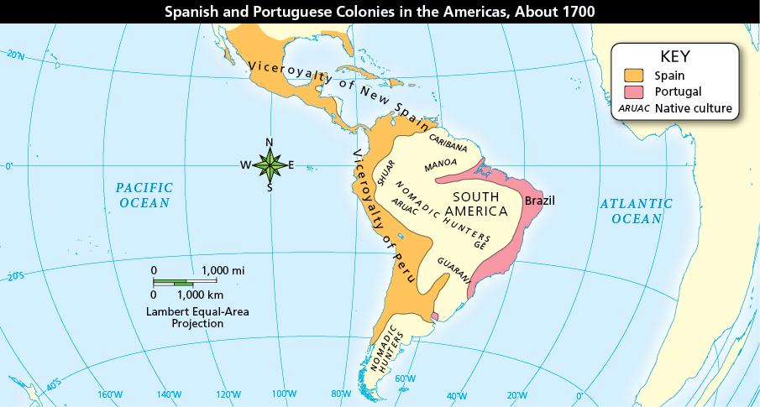
Governing the Spanish Empire
Analyze Maps What do all the European land claims in South America have in common? Which country settled the easternmost region?

Slide 16
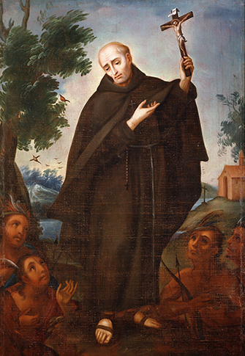
Governing the Spanish Empire
Wherever the Spanish established colonies in the Americas, missionaries sought to convert the Native Americans to Christianity.

Slide 17
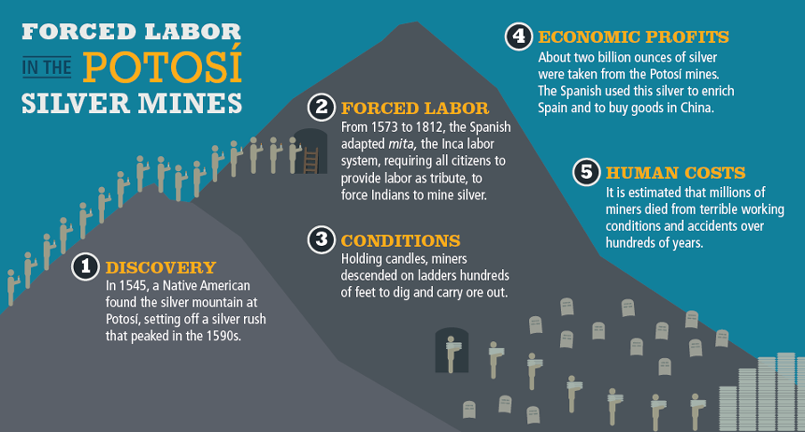
Governing the Spanish Empire
While the process of extracting silver from the Potosí mines was terribly destructive for Native American and other forced laborers, it proved immensely profitable for Spain.

Slide 18
Society and Culture in Spanish America
A Society of Unequal Classes
At the top are peninsulares, people from Spain who run govt. and Church officials
Creoles are American born descendants of Spanish settlers. They own plantations, ranches, and mines
Mestizos are people of Native American and European descent
Mulattoes are African and European descent
Native Americans and Africans form the lowest social class
Thriving Towns and Cities
Spanish settlers will live in towns and cities
These cities are centers of government, commerce, and European culture. They are also the center of intellectual and cultural life
Mexico City will be the largest Spanish speaking city in the world

Slide 19
Society and Culture in Spanish America
Educational Opportunities
To have educated priests, colleges will be built. The University of Mexico will start in 1551. A dozen colleges will be built before Harvard makes its debut
Women wanting an education would join a convent like Sor Juana Ines de la Cruz who became one of the greatest Spanish poets.
A Blending of Cultures
Spanish settlers will eat native foods, travel how the natives travel, and see native style of building
Natives will learn about religion and about animals, like the horse, from the Spanish
Africans will contribute with their cooking style, farming methods, drama, dance, and song
In Haiti, Cuba, and elsewhere Africans will form new religions that combine African and Christian beliefs

Slide 20
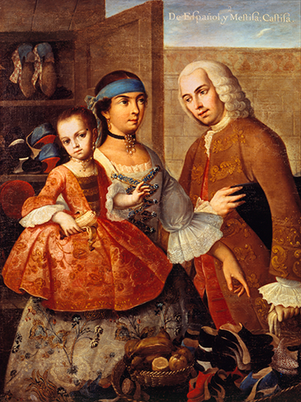
Society and Culture in Spanish America
This Mexican painting from the 1700s shows a Spanish man with his Native American wife and their mestizo child, who is trying on a new pair of shoes.

Slide 21
The Impact of Spanish Colonization
Spain Wins Wealth and Power
Spain will become the most powerful European Nation in the 1500’s because of all the gold and silver found in the Americas
Native American Suffering and Resistance
Many Native Americans will suffer and die because of European conquest
Still others will resist like the Mayans and Incas
Others will resist by preserving their culture, languages, religious traditions, and skills.

Slide 22
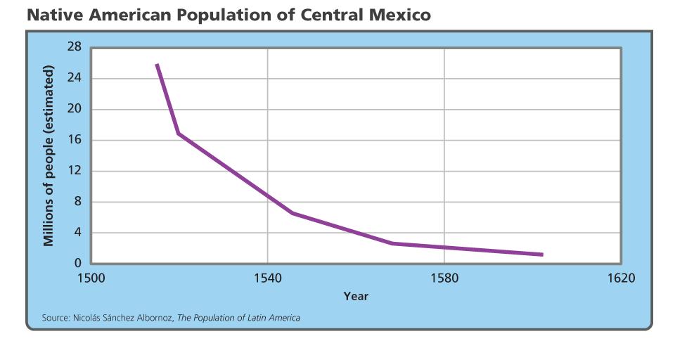
The Impact of Spanish Colonization
Analyze Graphs What is the estimated population decline between 1519 and 1540? How does it compare with the population change between 1540 and 1580? Why?

Slide 23
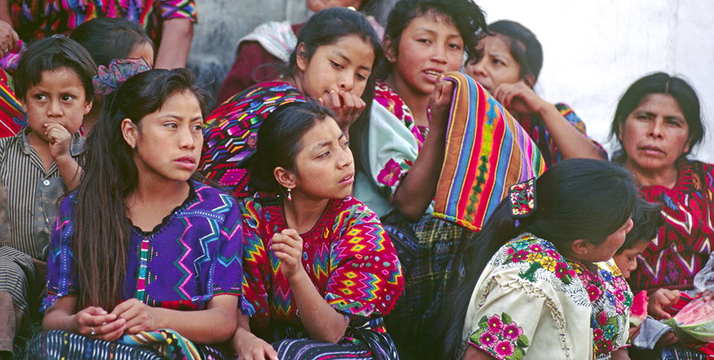
The Impact of Spanish Colonization
These Guatemalan Native American women wear brightly colored handwoven clothes, helping to preserve their culture’s traditions.

Slide 24
Quiz: First Encounters
When the Spanish first encountered Native Americans, they
A. set up trade colonies.
B. unknowingly exposed them to new diseases.
C. established a treaty to maintain peace.
D. initiated a civil war among Native American groups.

Slide 25
Quiz: Cortés Conquers the Aztecs
Why did Cortés want to conquer the Aztecs?
A. The Aztecs had attacked Spanish merchants.
B. He wanted to bring enslaved Aztecs to Spain.
C. He wanted Aztec land and riches.
D. He needed more soldiers for his army.

Slide 26
Quiz: The Incan Empire and Beyond
Which factors aided the Spanish conquest of the Incas?
A. European weapons and Indian allies
B. Peruvian geography and continuing famine
C. Inca poverty and disunity
D. Larger number of soldiers and guns in Spain’s army and Atahualpa’s ransom and conversion to Christianity

Slide 27
Quiz: Governing the Spanish Empire
What was the encomienda system?
A. a system in which Spanish monarchs shared with Native Americans the right to demand labor from peons and Africans
B. a system in which the Spanish conquistadors granted Native Americans the right to demand labor from peons
C. a system in which the Spanish monarchs granted the conquistadors the right to demand labor from Native Americans
D. a system in which the Spanish settlers granted the conquistadors the right to demand labor from Native Americans

Slide 28
Quiz: Society and Culture in Spanish America
Which statement best describes Spanish colonial society?
A. Except for Native Americans, all people were equal.
B. Social rank was based on a person’s ethnic background.
C. Social rank was based on wealth and education.
D. Poor Spanish immigrants were the lowest class.

Slide 29
Quiz: The Impact of Spanish Colonization
What was one of the impacts of Spanish colonization on Native Americans?
A. The Maya and the Incas, realizing victory was impossible, surrendered and never again fought against the Spanish.
B. Native Americans lost most parts of their culture.
C. Tens of thousands of Native Americans died from disease, war, and forced labor.
D. Native American culture became the dominant aspect of Latin American culture.

